Slide 1

Customer Shopping Behavior Analysis
This project analyzes customer shopping behavior using transactional data to uncover insights into spending patterns, customer segments, product preferences, and subscription behavior. The goal is to guide strategic business decisions.

Slide 2

Project Overview & Dataset Summary
Project Goal
Uncover insights into spending patterns, customer segments, product preferences, and subscription behavior.
Dataset Size
3,900 rows and 18 columns of transactional data.
Key Features
Demographics, purchase details, shopping behavior, and subscription status.
Missing Data
37 values missing in the "Review Rating" column.

Slide 3

Exploratory Data Analysis (EDA) with Python
Our EDA process involved several key steps to prepare the data for analysis:
Data Loading: Imported the dataset using pandas.
Initial Exploration: Checked structure and summary statistics.
Missing Data Handling: Imputed missing "Review Rating" values using the median.
Column Standardization: Renamed columns to snake case for readability.
Feature Engineering: Created "age_group" and "purchase_frequency_days" columns.
Data Consistency Check: Dropped redundant "promo_code_used" column.
Database Integration: Loaded cleaned data into PostgreSQL for SQL analysis.

Slide 4

SQL Analysis: Key Business Transactions
Revenue by Gender
1
Female: $75,191, Male: $157,890
High-Spending Discount Users
2
Identified 839 customers who used discounts but spent above average.
Top 5 Products by Rating
3
Gloves (3.86), Sandals (3.84), Boots (3.82), Hat (3.80), Skirt (3.78).
Shipping Type Comparison
4
Standard: $58.46, Express: $60.48

Slide 5


Subscription & Discount Insights
Subscribers vs. Non-Subscribers
Discount-Dependent Products
Subscribers: 1,053 customers, Avg Spend: $59.49, Total Revenue: $62,645
Top 5 products with highest percentage of discounted purchases: Hat (50%), Sneakers (49.66%), Coat (49.07%), Sweater (48.17%), Pants (47.37%).
Non-Subscribers: 2,847 customers, Avg Spend: $59.87, Total Revenue: $170,436

Slide 6

Customer Segmentation & Product Preferences
1
1
Customer Segmentation
Top 3 Products per Category
Loyal: 3,116, Returning: 701, New: 83
Accessories: Jewelry, Sunglasses, Belt. Clothing: Blouse, Pants, Shirt. Footwear: Sandals, Shoes, Sneakers. Outerwear: Jacket, Coat.
2
Repeat Buyers & Subscriptions
958 repeat buyers are subscribers, 2,518 are not.

Slide 7
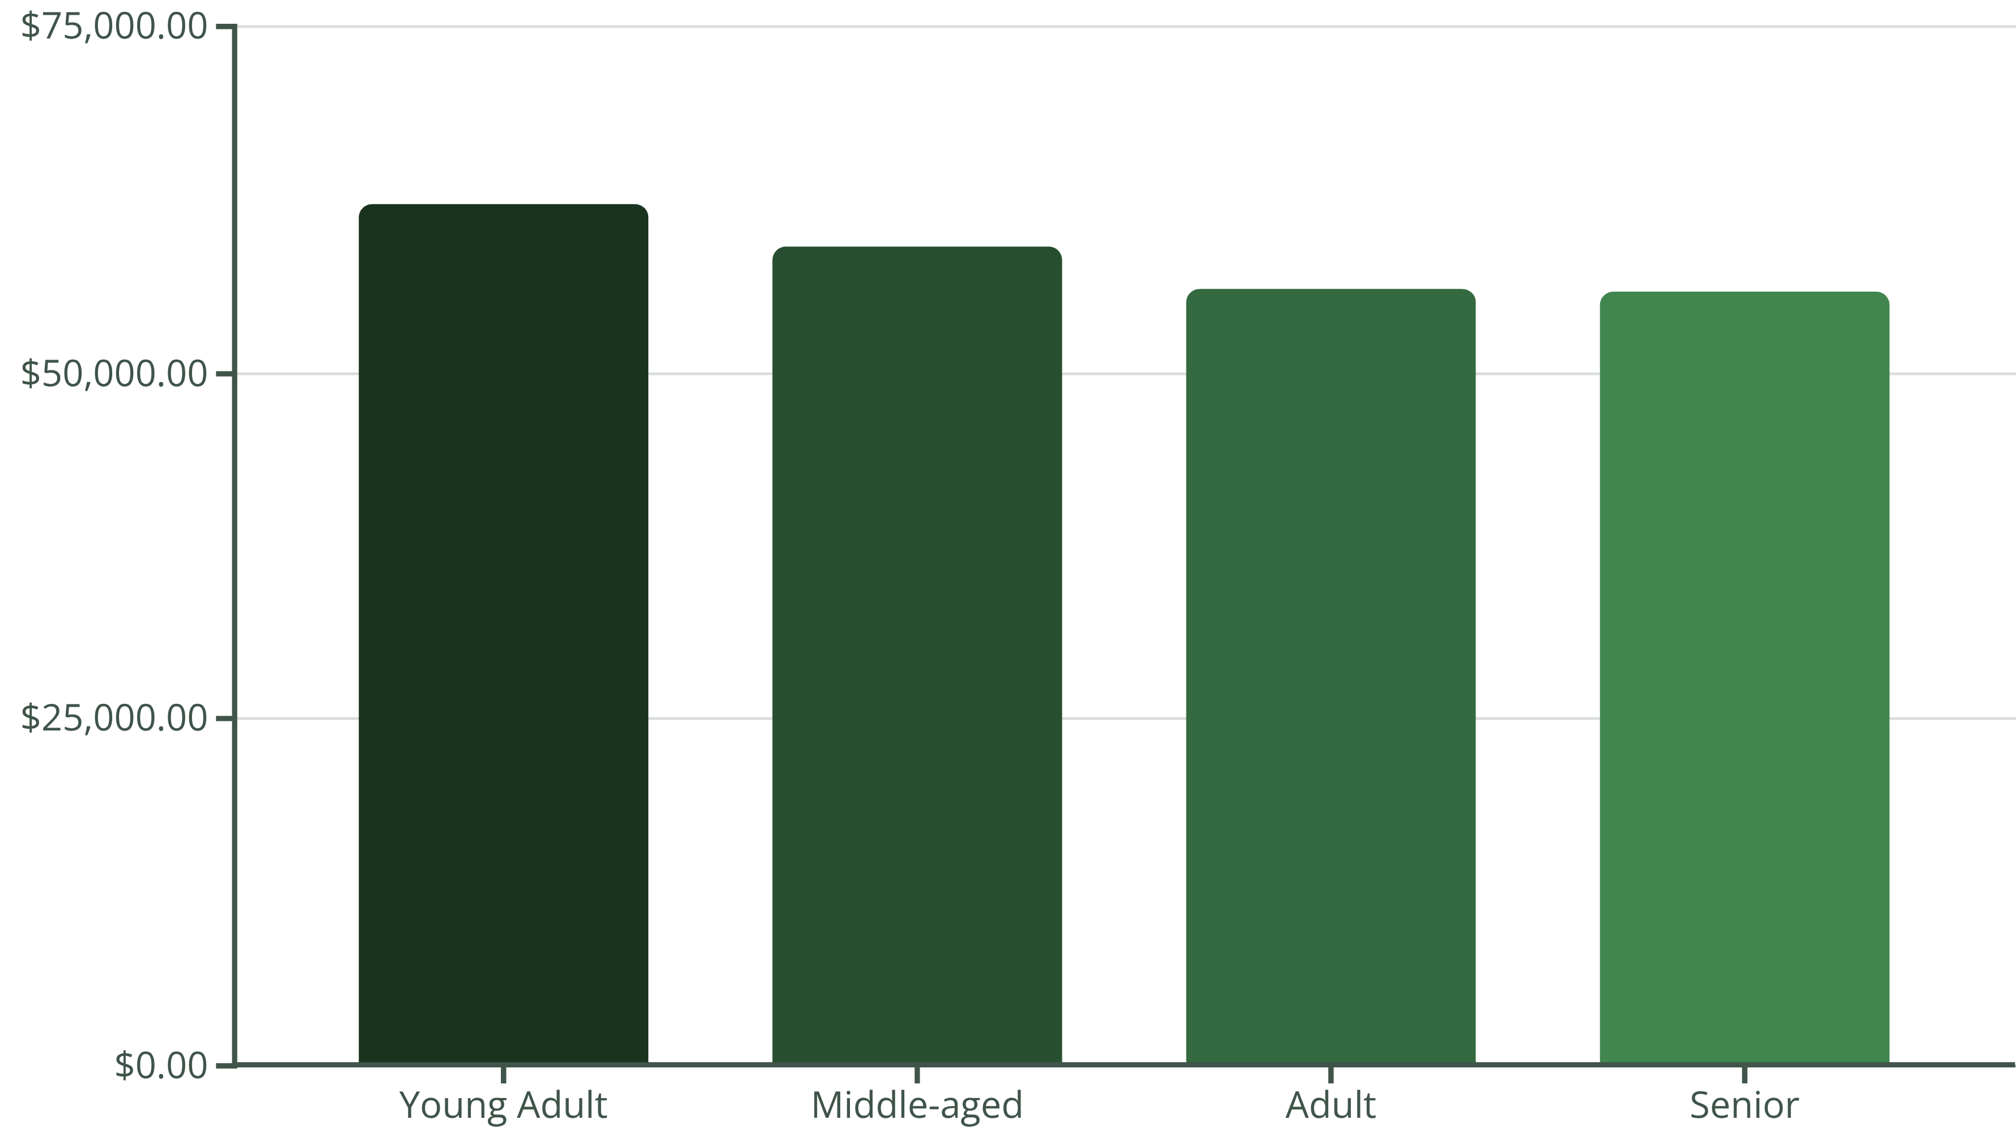
Revenue by Age Group
Young Adults contribute the highest revenue, followed closely by Middle-aged customers. This highlights the importance of targeting diverse age demographics.

Slide 8
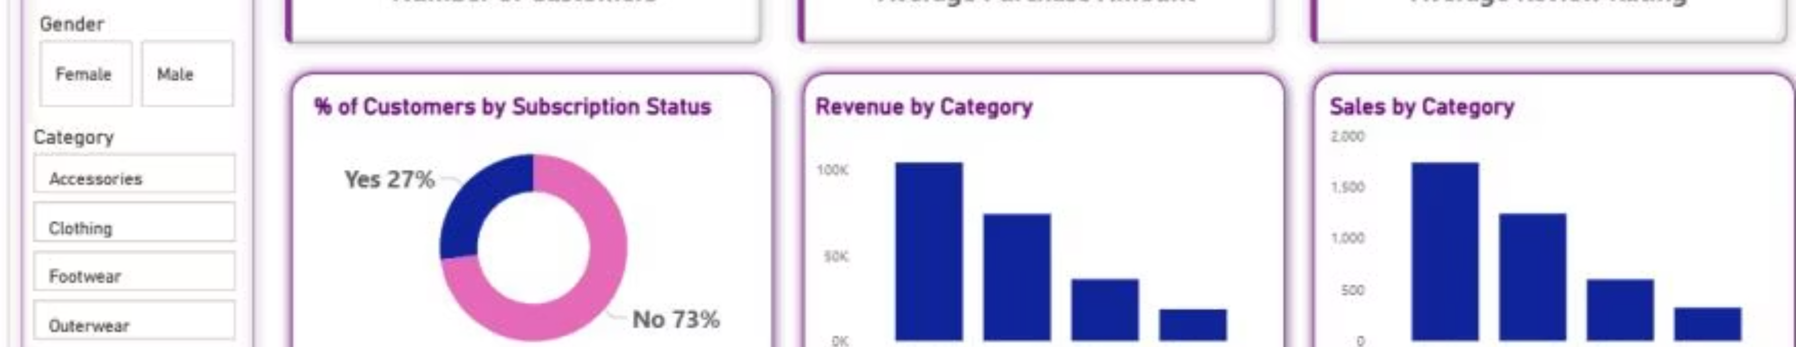
Power BI Dashboard: Key Metrics
3.9K
$59.76
3.75
Customers
Avg. Purchase
Avg. Review
Total number of unique customers analyzed.
Average amount spent per purchase.
Overall average review rating across all products.

Slide 9

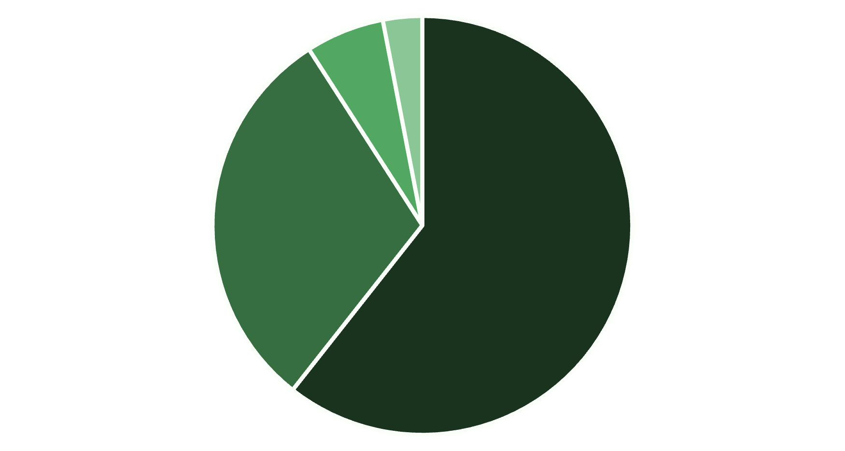

Dashboard: Customer & Revenue Insights
27%
Subscribed
Percentage of customers with an active subscription.
Clothing
Accessories
Footwear
Outerwear
73%
Clothing generates the highest revenue, followed by Accessories.
Non-Subscribed
Percentage of customers without a subscription.
The majority of customers are not subscribed, indicating an opportunity for growth.

Slide 10
Business Recommendations
Boost Subscriptions
Promote exclusive benefits to increase subscriber base.
Customer Loyalty Programs
Reward repeat buyers to foster loyalty and retention.
Review Discount Policy
Balance sales boosts with profit margin control.
Product Positioning
Highlight top-rated and best-selling products in marketing campaigns.
Targeted Marketing
Focus efforts on high-revenue age groups and express-shipping users.

